Slide 1
Hands-on workshop
Penetration testing and offensive security
Presentenced by jon helmus

Slide 2
Welcome!
Hands On Penetration Testing
Offensive Security
Cybersecurity
Banter is welcomed

Slide 3
Shoutouts
CityU of Seattle
Kim Nguyen
Instructor
You!

Slide 4


Special THanks
City University of Seattle
Multiple Programs
Computer Science
Cybersecurity
Offers programs at Undergrad and Graduate Level in CS and IT

Slide 5

Special thanks
Kim Nguyen
President at CityU Tech Club and Teaching Assistant at City University of Seattle
Researcher
Programmer
nguyenkim@cityuniversity.edu

Slide 6

Jon Helmus
OSCP, Pentest +, C|EH
Naval Engineer (U.S.Navy)
Helpdesk Specialist
Firewall Technician
Information System Security Engineer
Pentester
Red Teamer
Professor
Content Writer (CompTIA, Medium)
Technical Project Manager
Bug Bounty Hunter (Hackerone, Bug Crowd)
Security Researcher (AWS)
Author (Pending)
DCS/PhD Student
Farmer

Slide 7


Thanks!
Audience
Attendees
Curious People

Slide 8

COURSE
Beginner friendly (No crazy exploits)
Fun and Interactive
SPEAK UP
There are no dumb questions
Non-Formal
Please refrain from vulgar language
0% tolerance on any negative comments towards the staff and the audience.

Slide 9


Advisory
The techniques and lessons observed and learned in this workshop are used for educational purposes only. Please do not use anything learned in this workshop for malicious purposes.

Slide 10
Prerequisites
IT Fundamentals
Coffee
Creative mindset

Slide 11
Course Materials
Virtual Box
Kali Linux
Metasploitable (Vulnerable VM)

Slide 12
Target Audience
Students
IT Professionals interested in Penetration Testing

Slide 13
Learning objectives
Basic understanding of Penetration Testing
Have Fun!

Slide 14

Agenda
What is pentesting?
Roadmaps
Hands-On Learning
Conclusion (Day 2)
Q/A (Day 2)

Slide 15

Penetration Testing (Pentesting)
Penetration testing, also known as pentesting, pentest or ethical hacking, is an authorized simulated cyberattack on a computer system, performed to evaluate the security of the system.

Slide 16
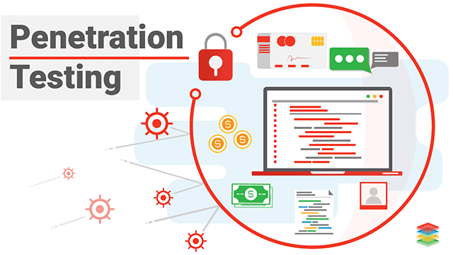
Pentesting Cont...
Penetration testing is more than just “hacking things”. In fact, penetration testing is a lot more research and writing than actual hacking. For example, imagine you are scrolling around on medium looking for an article that has to do with “X”. X can equal whatever you want, but “X” will define the scope of what you are looking for. Once you find “X” you read about it and possibly find more stuff about “X”. Think of that has lateral movements.

Slide 17

Pentesting Cont...
Imagine you have to write out a comprehensive report that details every step that you made before, during, and after your medium article search. This report will illustrate “why” and “what” of your search, while also displaying ways of how to search better on the go-around.
THAT’S Pentesting.

Slide 18

Reason for Pentesting
Notes:
Reactive

Slide 19
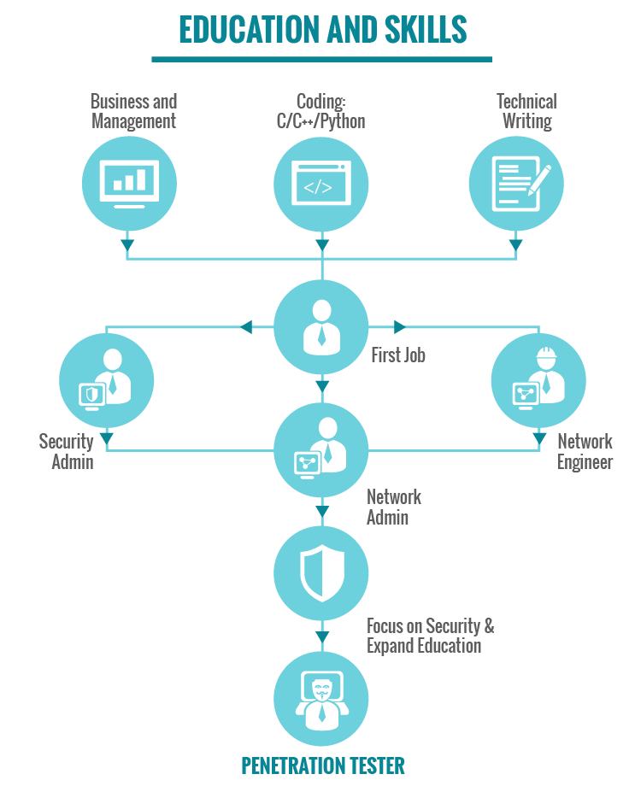
Roadmaps

Slide 20
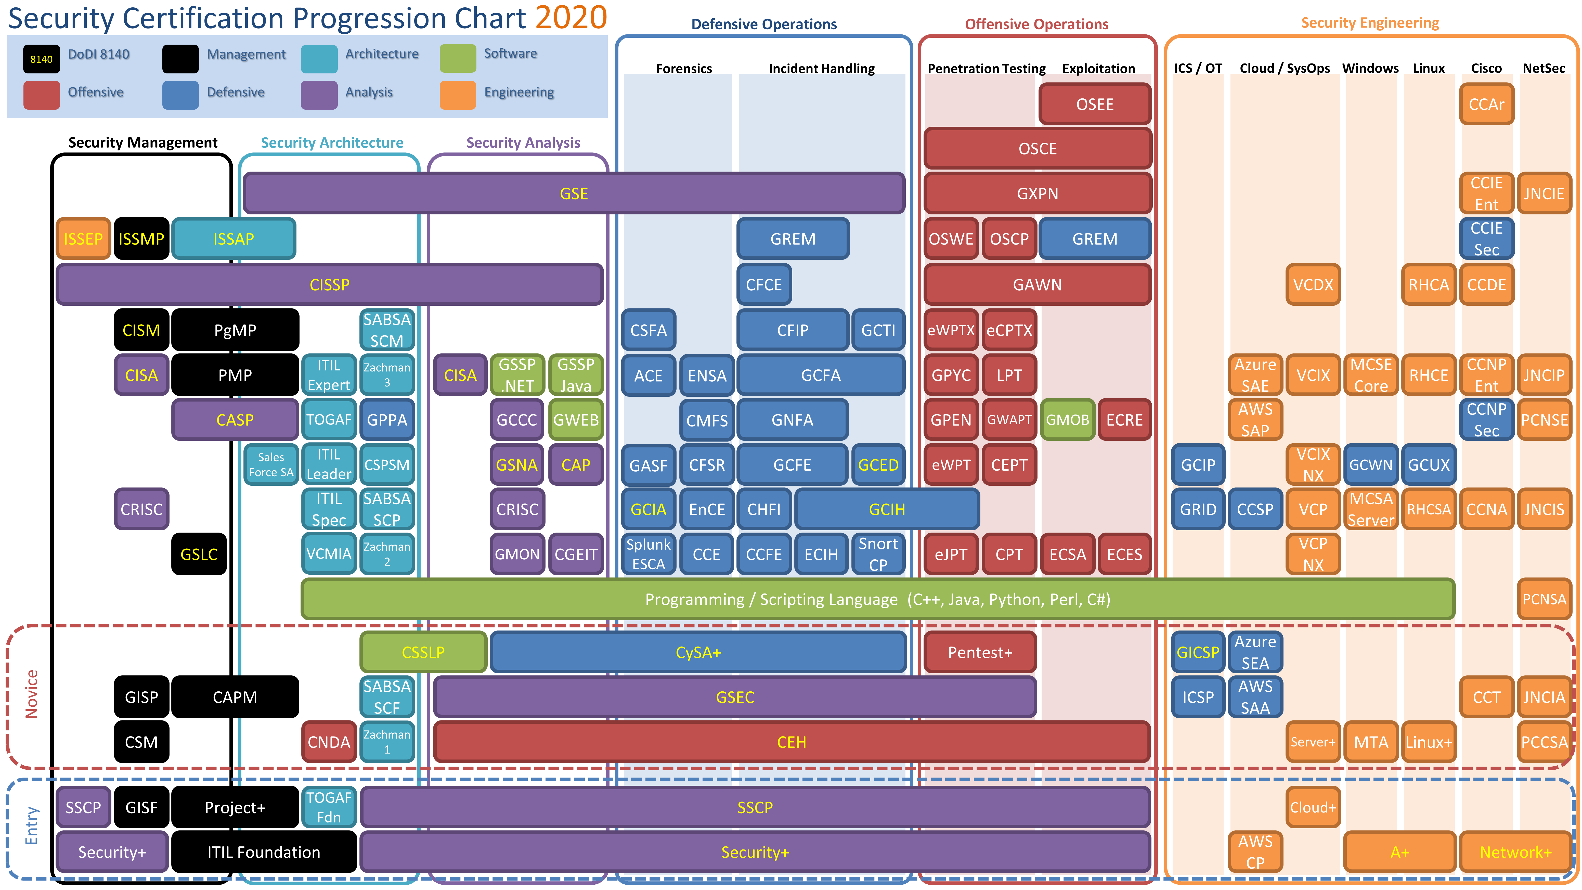
Roadmaps

Slide 21
Certifications
Security +
Certified Ethical Hacker (Written)
Junior Penetration Tester
Certified Ethical Hacker (Practical)
Pentest +
Offensive Security Certified Professional (OSCP)
Notes:
Not Difficult
Less difficult
Difficult
Very Difficult
Extremely Difficul

Slide 22
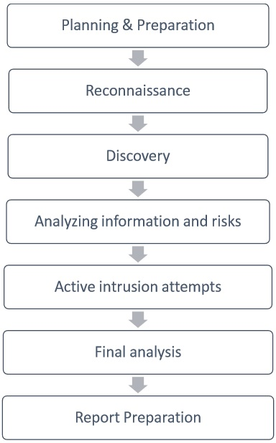
Steps of pentesting
Basic pentesting steps
Each step needs to be executed correctly and efficiently
We will be applying some of these in this workshop!

Slide 23

Time for hands on!

Slide 24

Before we start
Take a moment to set up your environment
Kali Linux
Metasploitable
Grab Some Coffee!
Make sure you have a NAT network for your machines to live on.

Slide 25
OSINT
Open source intelligence gathering
Great way to automate basic discovery of open resources
Often used as an initial attack vector

Slide 26
OSINT Tools
theHaverster
Google Dorking
GreyHatWarfare

Slide 27
The harvester
The objective of this program is to gather emails, subdomains, hosts, employee names, open ports and banners from different public sources like search engines, PGP key servers and SHODAN computer database.
Hands-On Time!

Slide 28
Google dorks
Google hacking, also named Google dorking, is a hacker technique that uses Google Search and other Google applications to find security holes in the configuration and computer code that websites use.
Hands-On Time!

Slide 29
GreyHatwarfare
Web Application built to discover open S3 buckets.
S3 buckets are a file system that belongs to AWS.
Hands-On Time!

Slide 30
Scanning and enumeration
Scanning provides details of the targets during your engagement.
Enumeration entails gathering information about targets such as ports, services, versions, etc.
Enumeration is one of the most important aspects of penetration testing!
We will be focusing on system scanning for right now!

Slide 31
Scanning tools
NMAP
Sparta

Slide 32
Nmap
Nmap is a free and open-source network scanner created by Gordon Lyon. Nmap is used to discover hosts and services on a computer network by sending packets and analyzing the responses. Nmap provides a number of features for probing computer networks, including host discovery and service and operating system detection

Slide 33


Nmap & Sparta
Scanning systems to find versions, services, ports, protocols, and more!
Hands-On Time!
We will look at Sparta too!

Slide 34
Attacking services
Involves attacking services running on specific host.
Services run on various ports that may are may not be accessible to the outside world.
FTP typically runs on port 21
SSH typically runs on port 22
These are default system ports.

Slide 35
Attacking FTp
File Transfer Protocol is a file transfer protocol that runs on port 21.
Based on previous scan, port 21 is open.
Let’s attack is an see what we can find.

Slide 36
Targeting FTP
Is anonymous FTP open?
Is it running on a common port?
What FTP service is running?
What is the version of the service?
Is there an exploit for this version?
Are there tools that help automate this? (?Metasploit?)

Slide 37
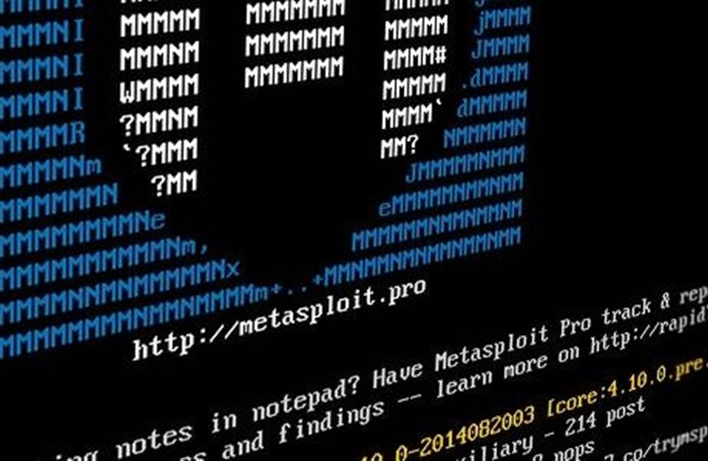
metasploit
Metasploit is a very popular tool used by penetration testers and security engineers.
It helps automate attacks and has a large library of exploits that can be used to exploit targets.

Slide 38
Attacking FTP
Hands-On Time!

Slide 39
Attacking low hanging fruit
Low hanging fruit typically vulnerable services that are extremely easy to exploit.
Left open and/vulnerable because:
Servers have been forgotten about
Services can’t be updated for due to business need
Lack of Security Awareness

Slide 40
Attacking Low hanging fruit
Let’s go back to our scan results and see what we can find.
Check some of the services and see what stands out.
A commonly misconfigured service SAMBA.

Slide 41
ATTACKING SAMBa
Samba is a Linux variation of SMB that allows file and printer sharing .
Let’s inspect our target for SAMBA.

Slide 42
ATTACKING SAMBa
Hands-On Time!

Slide 43
Web Application Pentesting
Important because everything is a web application now!
Bug Bounty programs make web pentesting a great way to learn more with less headache!
Bug Crowd
HackerOne

Slide 44
OWASP top 10 Web Pentesting
Injection
Broken Authentication
Sensitive Data Exposure
XML External Entity
Broken Access Code
Security Misconfiguration
Cross Site Scripting
Insufficient Logging

Slide 45
Scanning a webserver
Scanning a web server is similar to scanning a host. In the previous exercises, we used a tool called NMAP to scan are host for open ports and services. Now we are going to take a quick look at a tool that will do some scanning for the web sites hosted on our target.

Slide 46
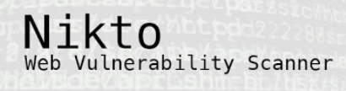
Website Scanning
Used for scanning websites
Easy to use
Automated

Slide 47
Scanning webservers
Hands-On Time!

Slide 48
Remote Code Execution (RCE)
Remote Code Evaluation is a vulnerability that can be exploited if user input is injected into a File or a String and executed (evaluated) by the programming language's parser. Usually this behavior is not intended by the developer of the web application. A Remote Code Evaluation can lead to a full compromise of the vulnerable web application and also web server. It is important to note that almost every programming language has code evaluation functions.

Slide 49
RCE prevention
Blacklist special characters
Evaluate user input with callbacks and checks

Slide 50
Attacking RCE
Hands-On Time!

Slide 51
Cross site scripting (XSS)
XSS attacks occur when an attacker uses a web application to send malicious code, generally in the form of a browser side script, to a different end user.
We will be looking at a simple, yet dangerous XXS called “Reflective XSS”.
Notes:
https://owasp.org/www-community/attacks/xss/

Slide 52
Attacking xss
Hands-On Time!

Slide 53
Injection
Injecting code to be interpreted and or executed.
We will be looking at some fundamental SQL injection (SQLi)

Slide 54
Attacking sqli
Hands-On Time!

Slide 55
Scenario
We have been hired on to assess a new apache tomcat server for a client.
The client would like us to test the following:
Brute Forcing
Web Vulnerabilities
If possible, fully exploiting the web server.

Slide 56
Attack plan
Discover web server
Discover services
Brute force web application
Check for common vulnerabilities
Get persistent access
Leave proof of exploitation

Slide 57
Attacker Scenario
Hands-On Time!

Slide 58
What we learned
Basics of pentesting
Attacking
Ports
Services
Low Hanging Fruit
Web Vulnerabilities

Slide 59

Staying Curious & Giving Back
Join online hacking forums
Reddit
Discord
Slack
Create a blog and publish writings
Technical & Non-Technical
Subscribe to Hacking Platforms
Hack The Box ($13 month)
VulnHub (Free)
TryHackMe.com ($8 month)
PentesterAcademy (12 month)
Find Your Niche!
Cloud
Development
System Security
Network Security
Academia

Slide 60
Staying Curious & Giving Back Cont...
Find a Mentor!
Find other student pentesters
Find a Mentee!
Bug Bounty Programs
Hackerone.com
BugCrowd.com

Slide 61

Closing Thoughts
Security is a journey, not a destination!
Notes:
This is a journey, not a sprint!

Slide 62

Follow Me
www.moos1e.com
https://medium.com/@jonathanchelmus
https://github.com/Moos1e
https://www.linkedin.com/in/jon-helmus-474146103/

Slide 63

???Questions???

